Slide 1


Capstone Project
DoConnect
Batch No : C4
Group : G3
Presentation by:
Abdul Rehaman Shaik
Om Sai Yadlapati
Saisree Badvelu
Chitikela Sai Teja
Niteesh Kumar Chintapalli
Patan Modin Khan
Under the Esteemed Guidance of :
Mr. Venkata Durga Prasad

Slide 2
Objectives:
Our project main objective is to allow people to ask any question and also to answer any question over the internet. Through our Do Connect website, a person can be able to question and answer for any of the topic.
The main objectives are as follows:
➢ Find the best solution for their questions.
➢ Can clarify their doubts.

Slide 3
Abstract :
We all previously know about Quora and Stack Overflow etc. In the same way Do Connect is a popular Q and A form in which technical questions can be asked and answered. One can be able to login, Logout and Register into the application. One can be able to ask any question under any topic. One can be able to search the topic on any string written in search box. One can be able to Answer any question asked. One can be able to answer more than one question and more than one time. One can be able to chat with other users. One can should be able to upload images to refer.

Slide 4
Functional Requirements:
User Stories:
As a user I should be able to login, Logout and Register into the application.
As a user I should be able to ask any question under any topic.
As a user I should be able to search the question on any string written in search box.
As a user I should be able to Answer any question asked.
As a user I should be able to answer more than one question and more than one time.
As a user I should be able to chat with other users.
As a user I should be able to upload images to refer.
Admin stories :
As an Admin I should be able to login, Logout and Register into the application.
As an Admin I should be able to get mail as soon as any new Question is asked or any Answers given.
As an Admin I should be able to approve the question and Answer. Any Question or Answer will be visible on the platform only if it is approved.
As an Admin I should be able to delete inappropriate Questions or Answers.

Slide 5
Functionality Of User:
Functionality Of Admin:
Register
Register
Login
Login
search
Approve questions
Approve Answers
User
Ask a question
Admin
Delete Questions
Can chat
Delete Answers
Add a Question
Get all users
Add Answer
Logout
Logout

Slide 6
System Specifications:
Software Requirements :
Technologies: Angular, Springboot
Languages: TypeScript,Java,SQL queries
IDE: Eclipse for Enterprise,VS Code
Hardware Requirements :
Operating system: Windows 7 or more,Linux
Processor: Intel or AMD dual core x86processor
RAM: 2GB or more
Hard disk: 500MB or more

Slide 7
Frontend:
The frontend is the user interface and the part of the application with which users directly interact. The back end usually refers server applications such as a database. You may also hear of middleware, the software that glues it all together. The front end of DoConnect is the software that generates this page and other pages on demand. One might argue that your browser is also part of the front end.
Backend:
The Backend of DoConnect might be the database that stores and manages our questions, answers, activity statistics, and other information needed to run DoConnect and provides the raw data used to populate our screens when we click the buttons. DoConnect surely has middleware to link up people, and components of the pages, such as the customized selection of ads and the operation of tracking sites or clickstream analysis.
DataBase:
Technology used: MySQL

Slide 8
FLOWCHART OF DOCONNECT
The flowchart of Do Connect in user :
USER SITE:
USER
LOGIN
No
REGISTER
YES
USERDASHBOARD
ASK A QUERY
RESPONSE TO QUERY
LOGOUT
No
YES
POST QUESTION
LOGOUT

Slide 9
ADMIN SITE:
ADMIN
LOGIN
VIEW QUESTIONS AND ANSWERS
YES
ACCEPT
REJECT
LOGOUT
No
LOGOUT

Slide 10
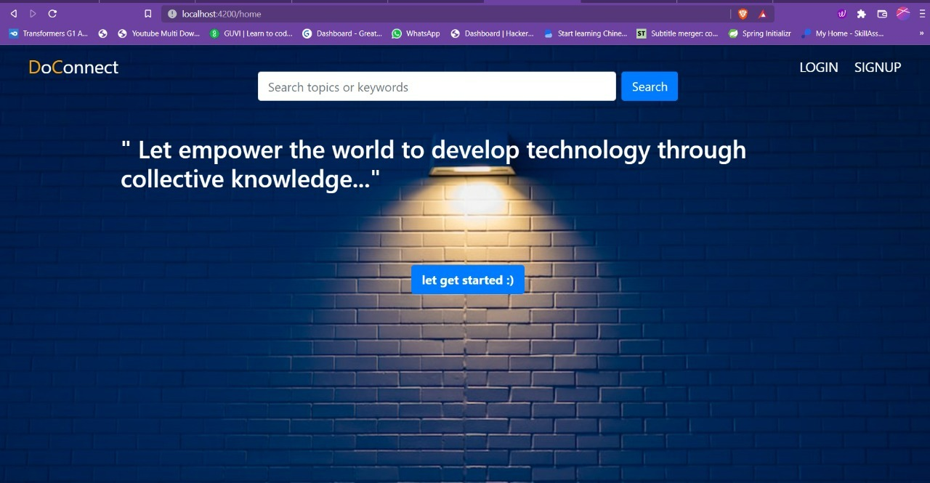
Result
Home Page

Slide 11
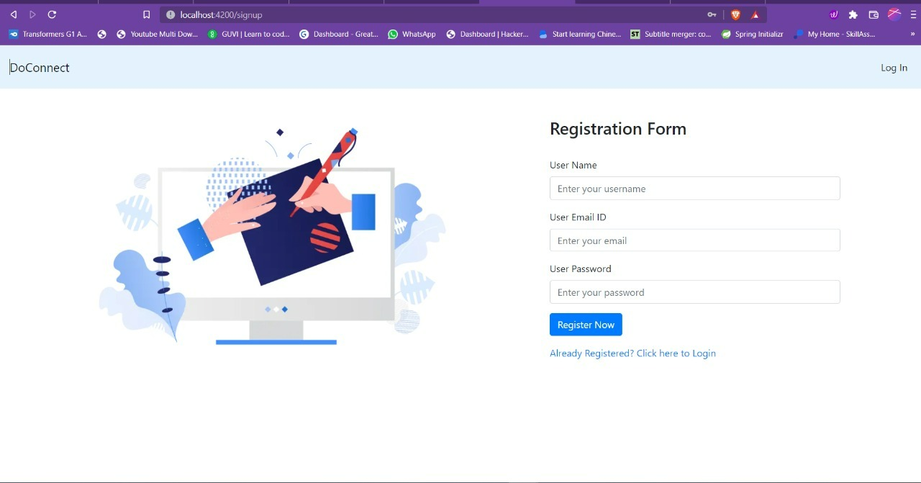
User Registration Form

Slide 12
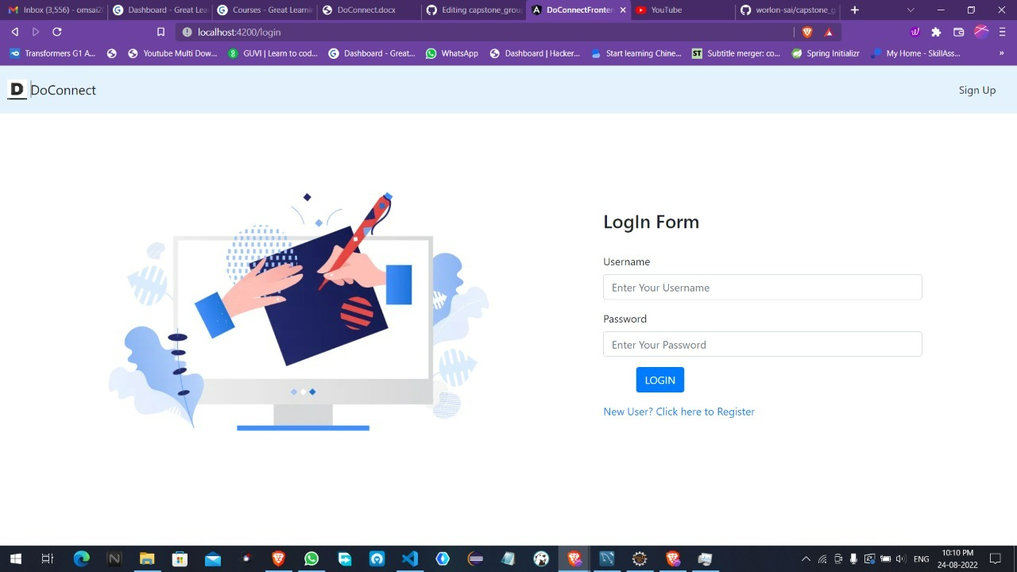
Admin Login Form:

Slide 13
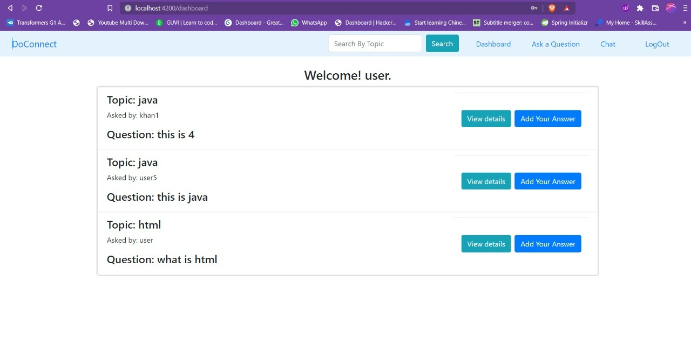
User Dashboard

Slide 14
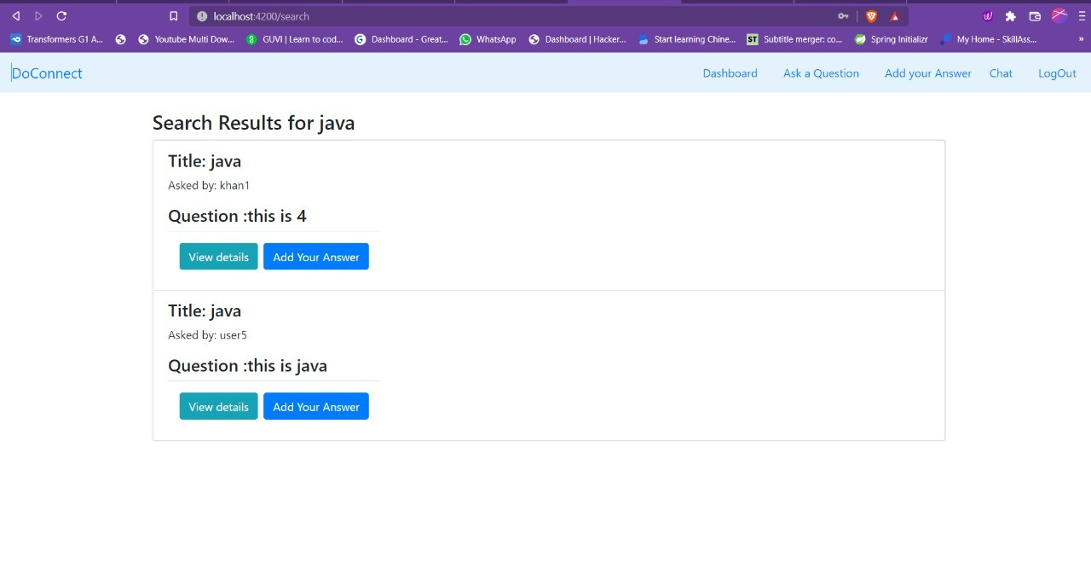
Search Results Page

Slide 15
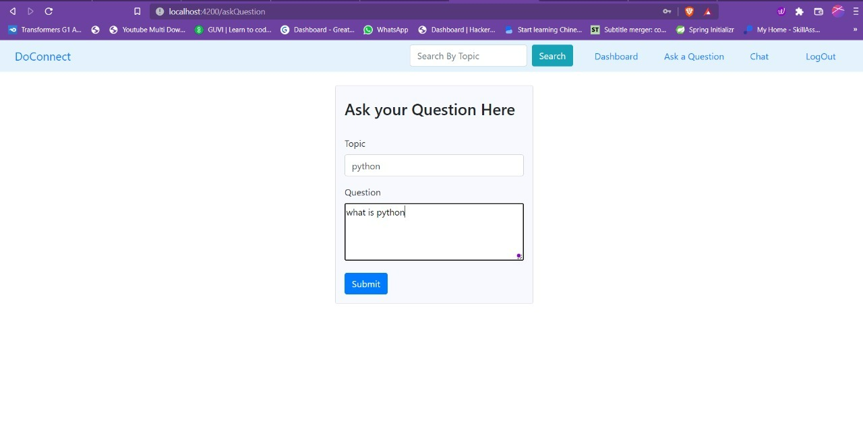
User Ask Question Page:

Slide 16
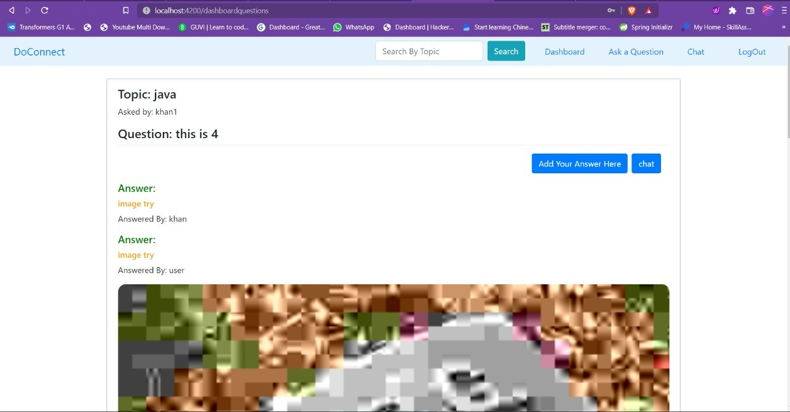
Answers Page:

Slide 17
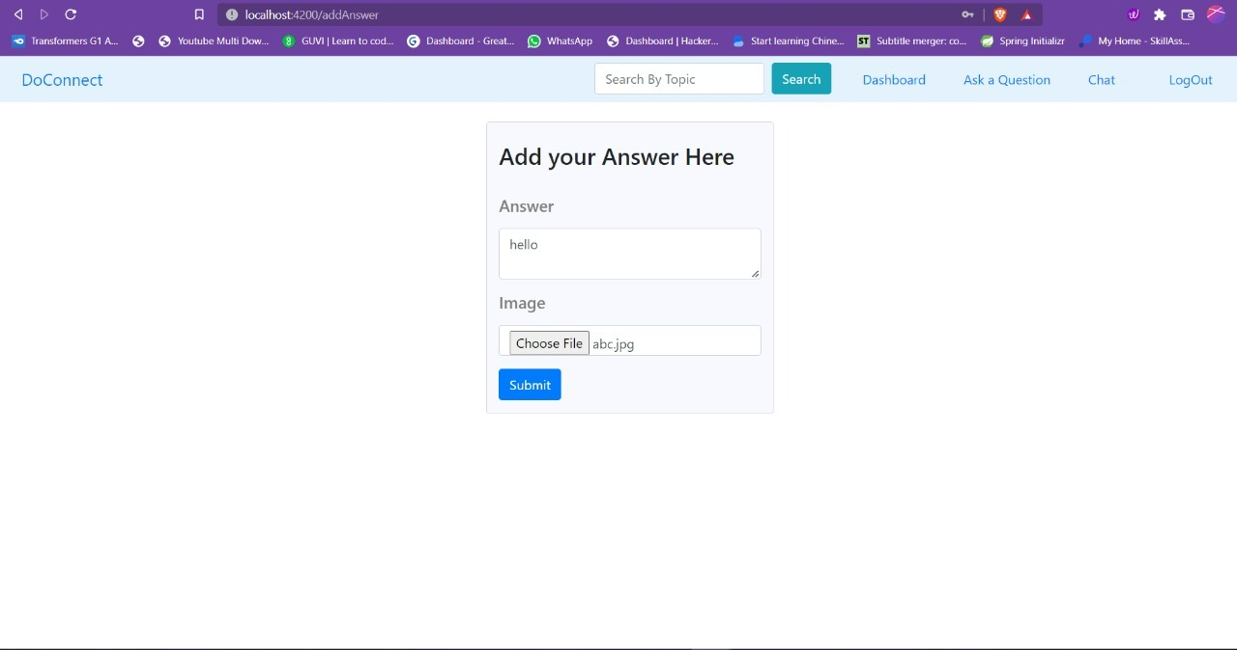
User Add Answer page

Slide 18
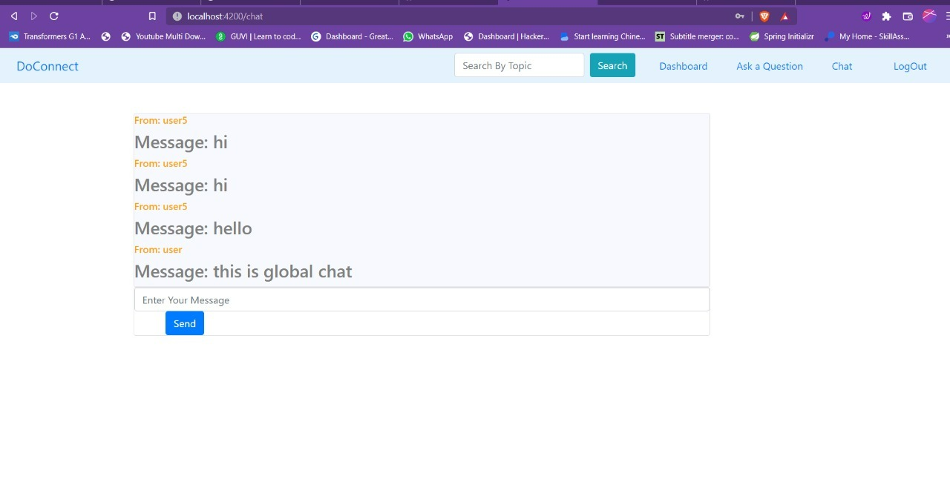
Global Chat page:

Slide 19
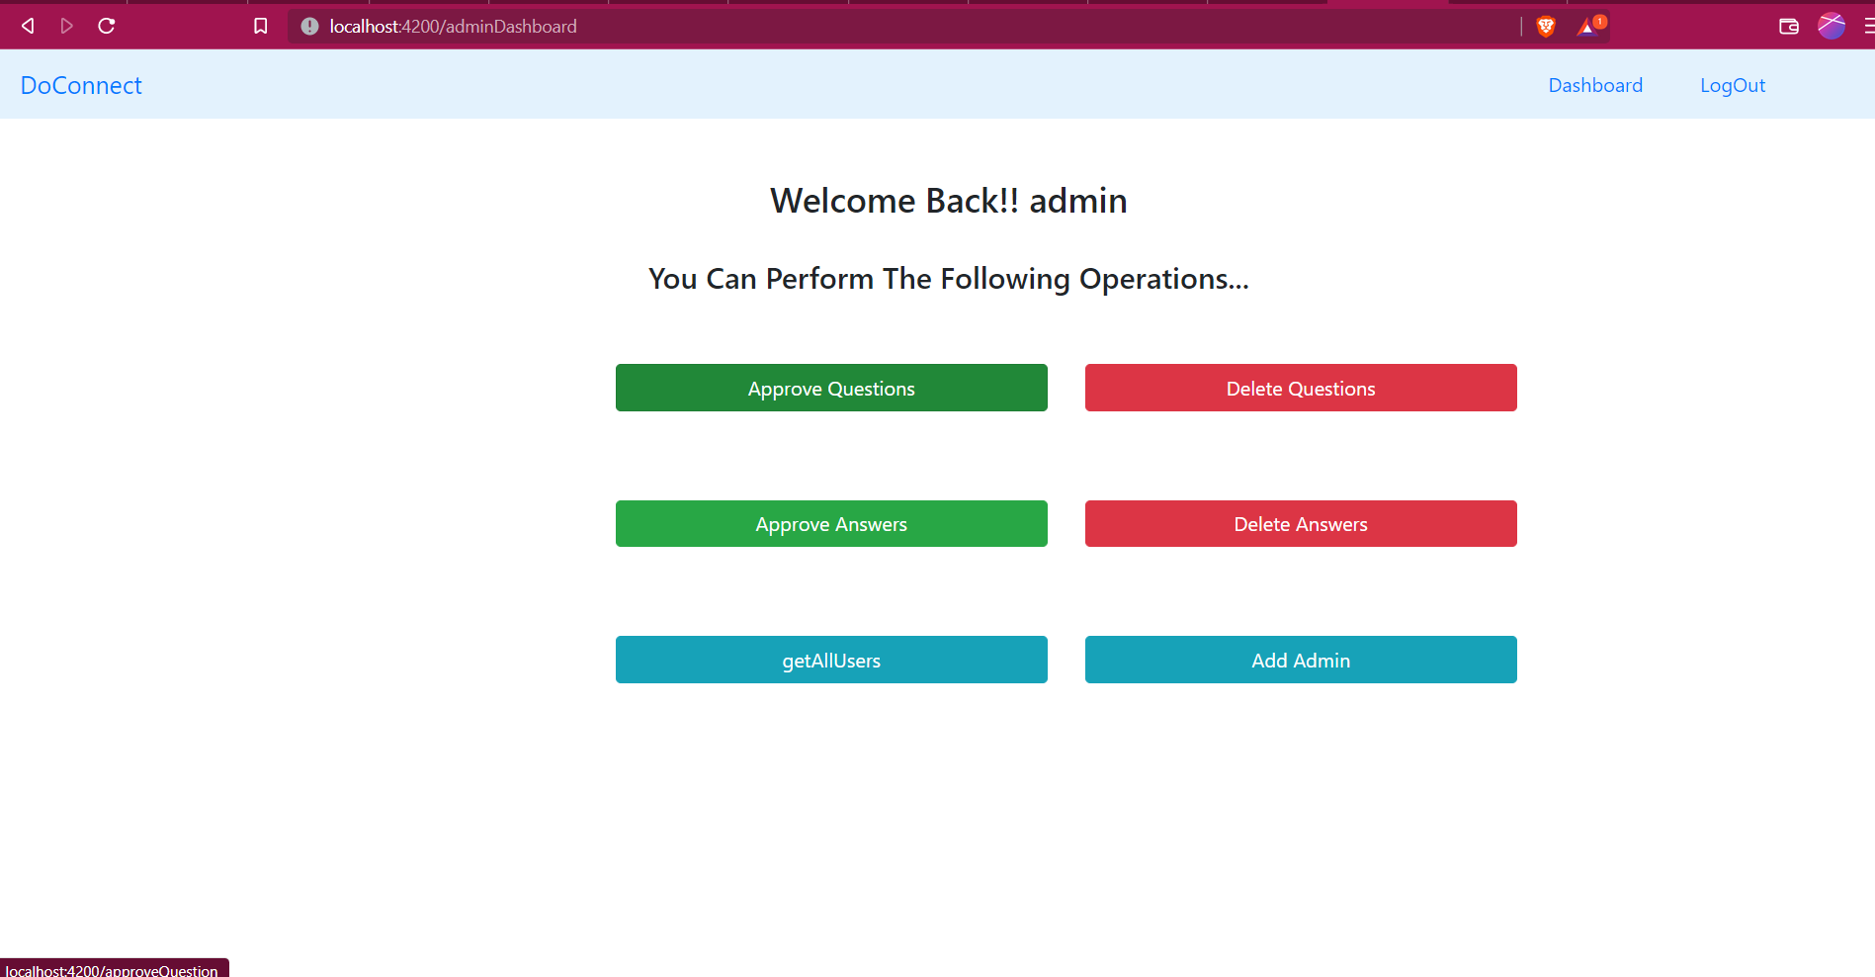
Admin Dashboard Page:

Slide 20
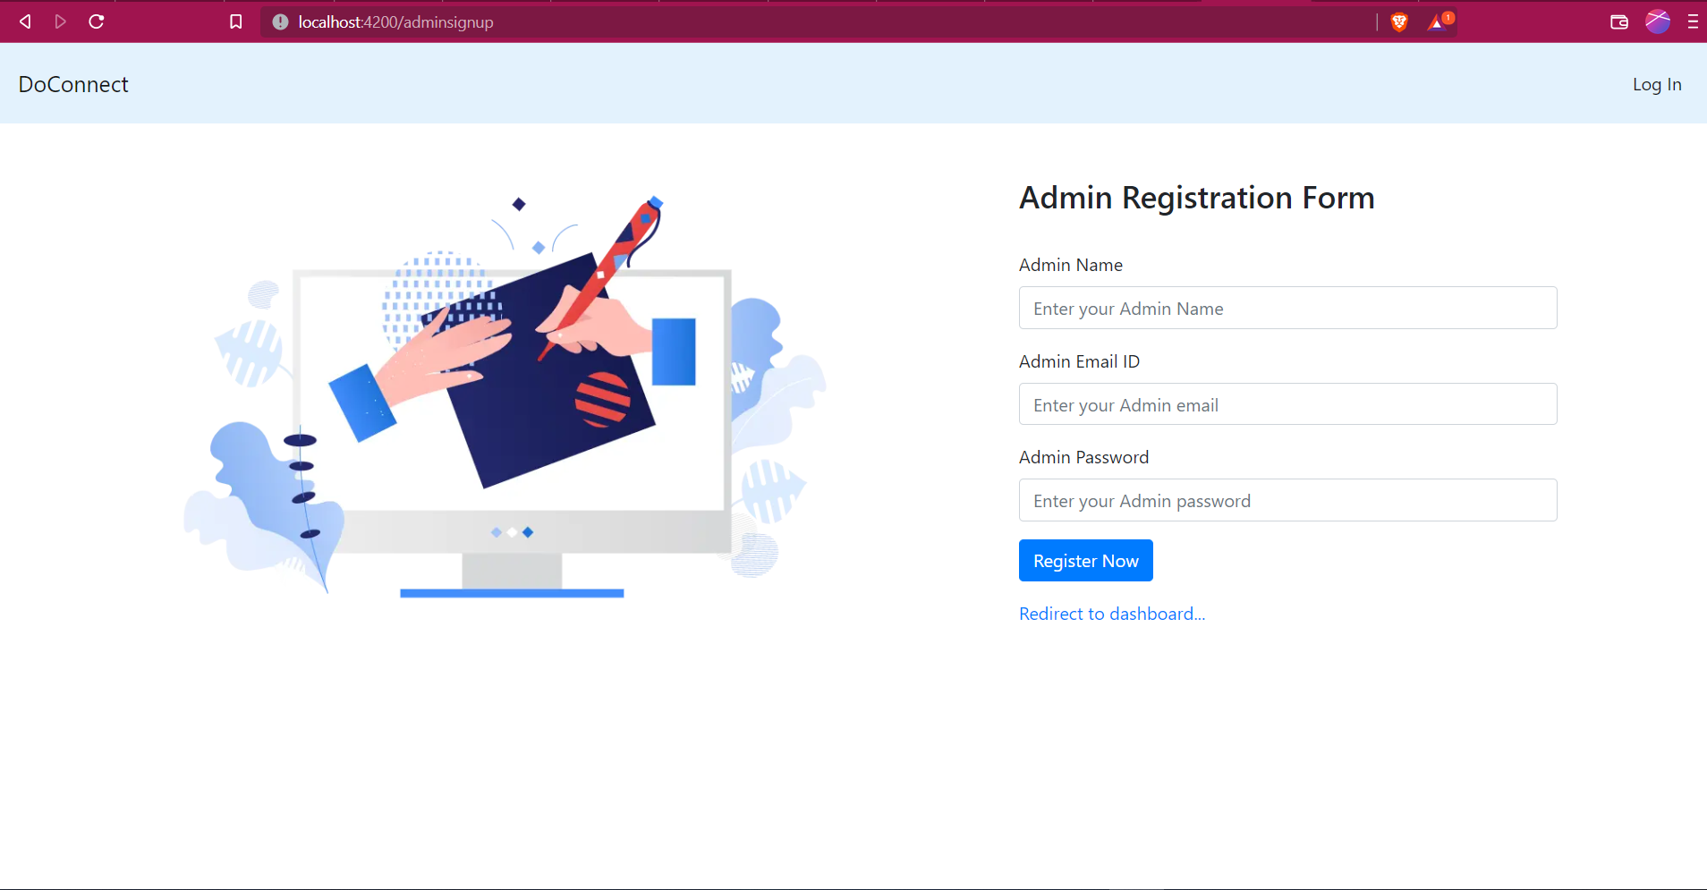
Admin Registration Form

Slide 21
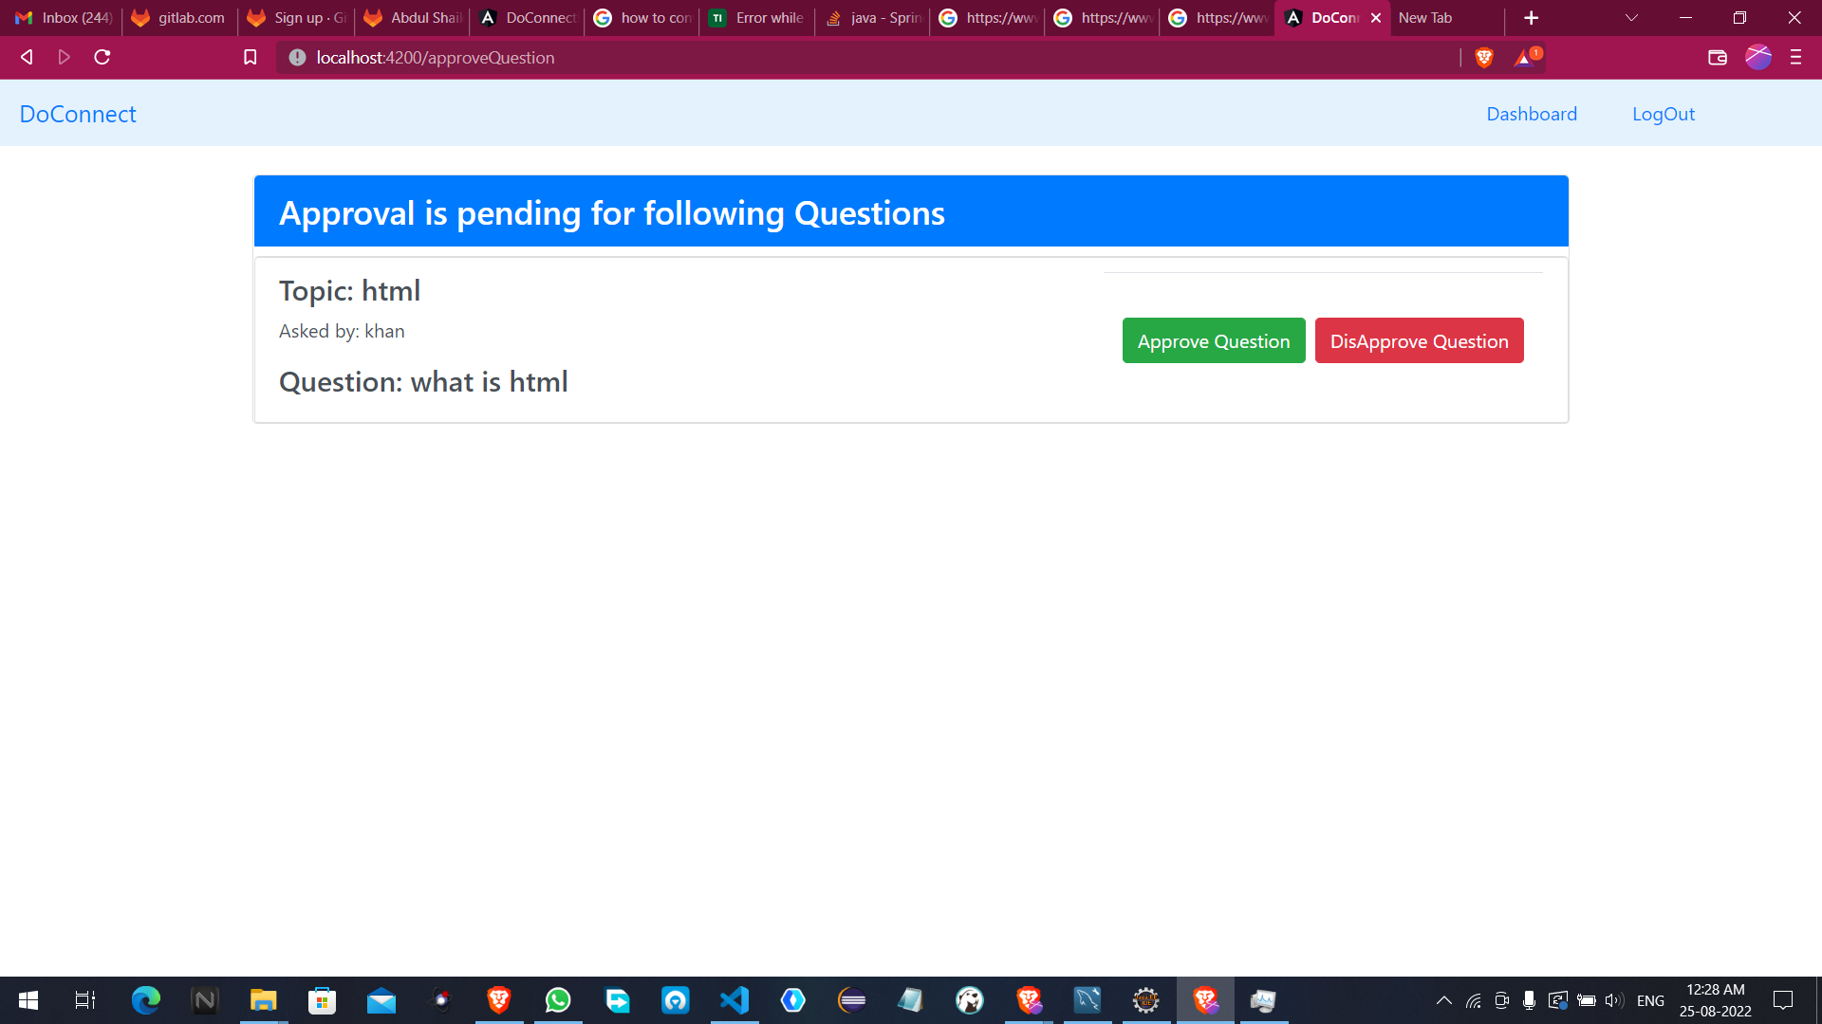
Admin Question Approval Page:

Slide 22
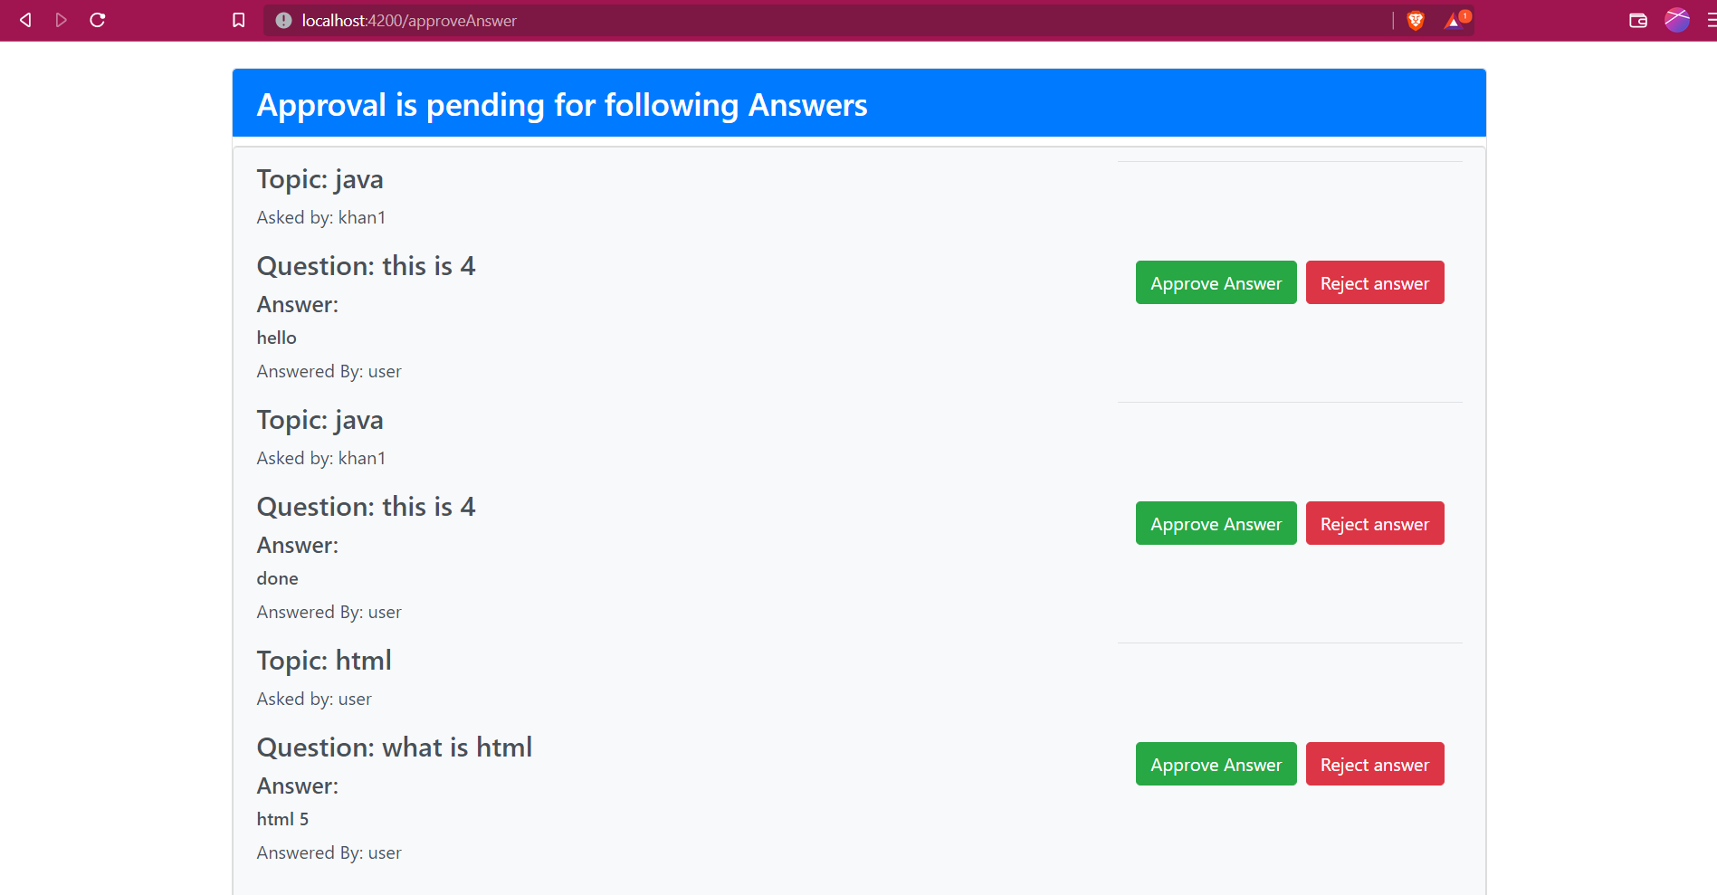
Admin Approval For Answer Page:

Slide 23
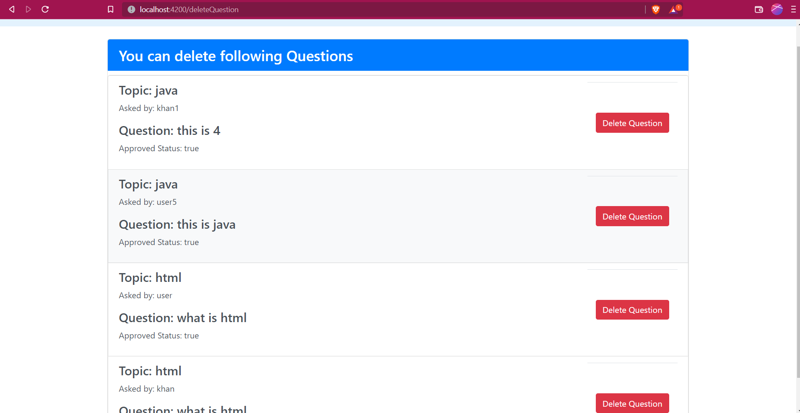
Admin Delete Question Page:

Slide 24
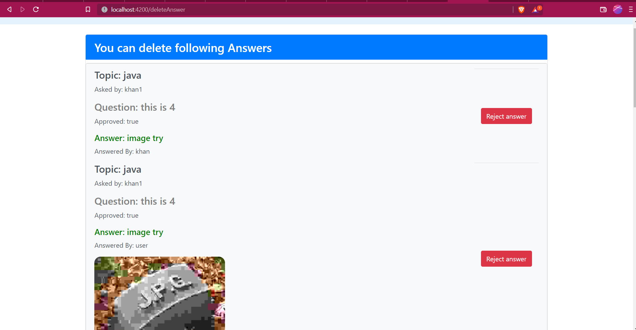
Admin Delete Answer Page

Slide 25
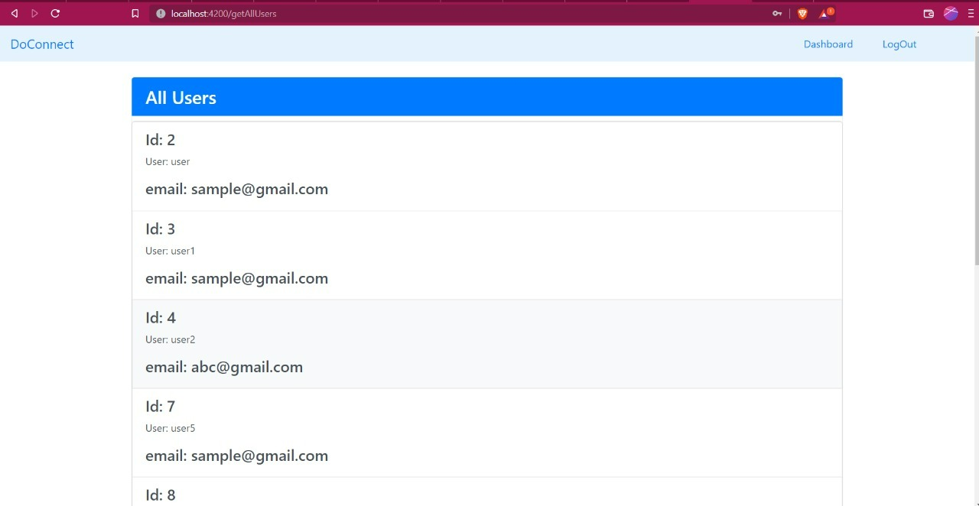
Show All Users Page:

Slide 26
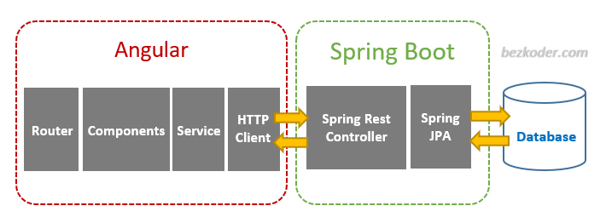
Overview:

Slide 27
Conclusion:
We conclude that we have created a Do connect application successfully with all the requirements mentioned in the given problem statement and we have successfully deployed our project in the Angular and spring boot.

Slide 28


